Slide 1
Evolution of CMEs in the Heliosphere: Status Report
Simon P. Plunkett
Naval Research Laboratory
Co-Is
Adam Szabo, Barbara Thompson (NASA/GSFC)
Dusan Odstrcil (U. Colorado)
Pete Riley (Predictive Science, Inc.)
STEREO SWG, Pasadena, CA
February 3 – 5, 2009

Slide 2
Research Objectives
How does the structure of CMEs evolve as they propagate through the inner heliosphere?
How are CMEs accelerated and/or decelerated as they propagate from the Sun to 1 AU and beyond?
How do the features of ICMEs observed in-situ reflect their solar origins and the appearance of CMEs in remotely sensed imaging data?

Slide 3
Approach
Combination of data analysis (SECCHI, IMPACT, PLASTIC, ACE, Wind) and numerical modeling (MAS, ENLIL) for selected events.
Focus on small number of events with well-observed flux rope structure (ideally well-observed in both remotely sensed and in-situ data).
Modeling in two steps:
  Drive ENLIL heliospheric model using cone model (or similar) fits to SECCHI coronagraph observations;
  Detailed self-consistent modeling using coupled coronal and heliospheric (MAS + ENLIL) codes for a subset of events.
Compare remotely sensed and in-situ data for events with suitable spacecraft configurations (e.g. imaging observations from Ahead of a CME that is observed in-situ from Behind).
Generate synthetic images and in-situ parameters from model results for comparison with data.

Slide 4
Progress to Date
Analyzed remote sensing and in-situ data for two CME events (April 26 and May 17, 2008).
ENLIL model has been run for both events, using both cone model and ‘croissant’ model parameterization of CMEs as inputs to ENLIL.
Comparison of data and model results is just getting started.

Slide 5
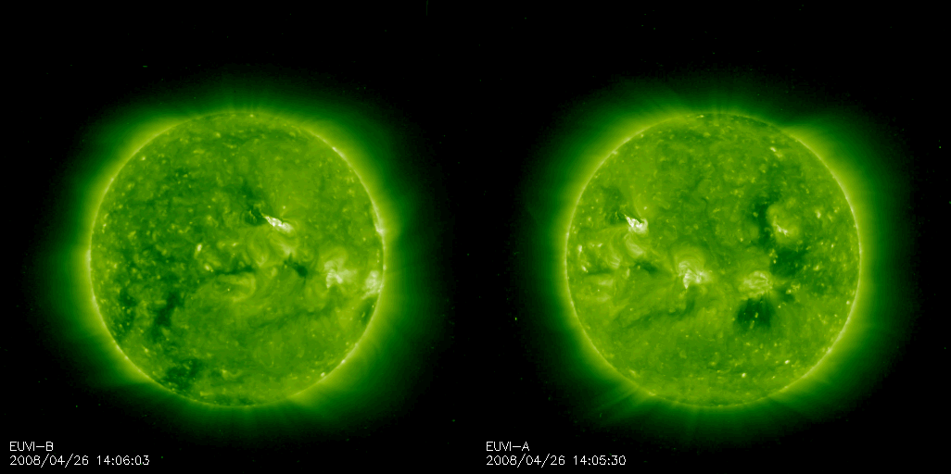
The Corona on April 26, 2008

Slide 6
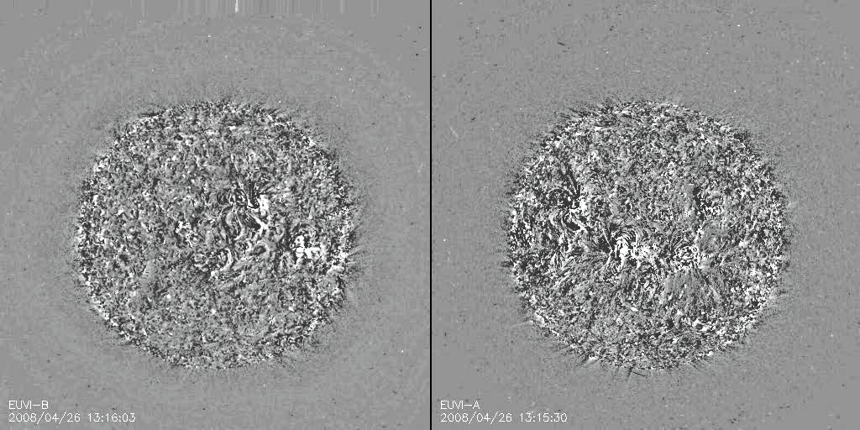
April 26, 2008 CME

Slide 7
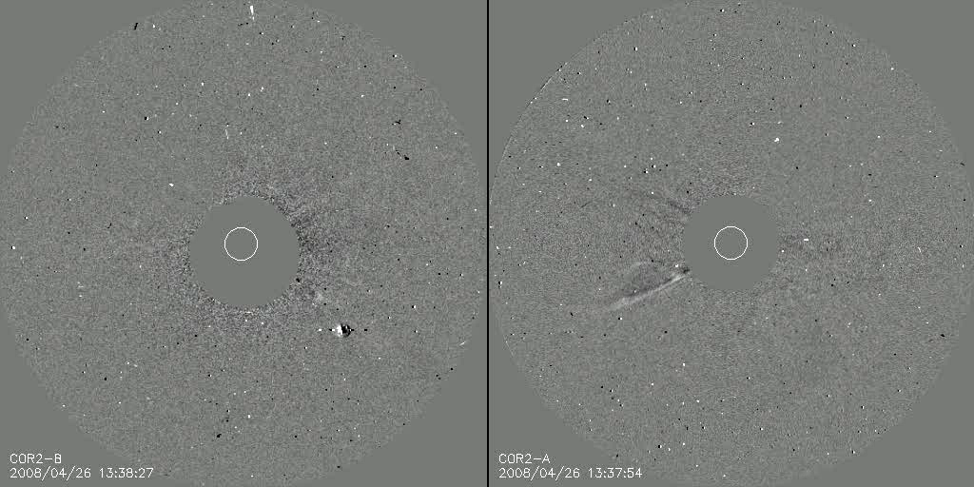
April 26, 2008 CME

Slide 8
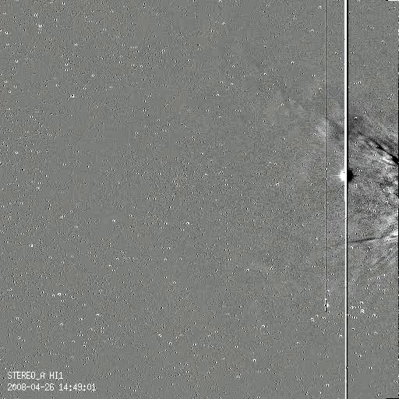
April 26, 2008 CME

Slide 9
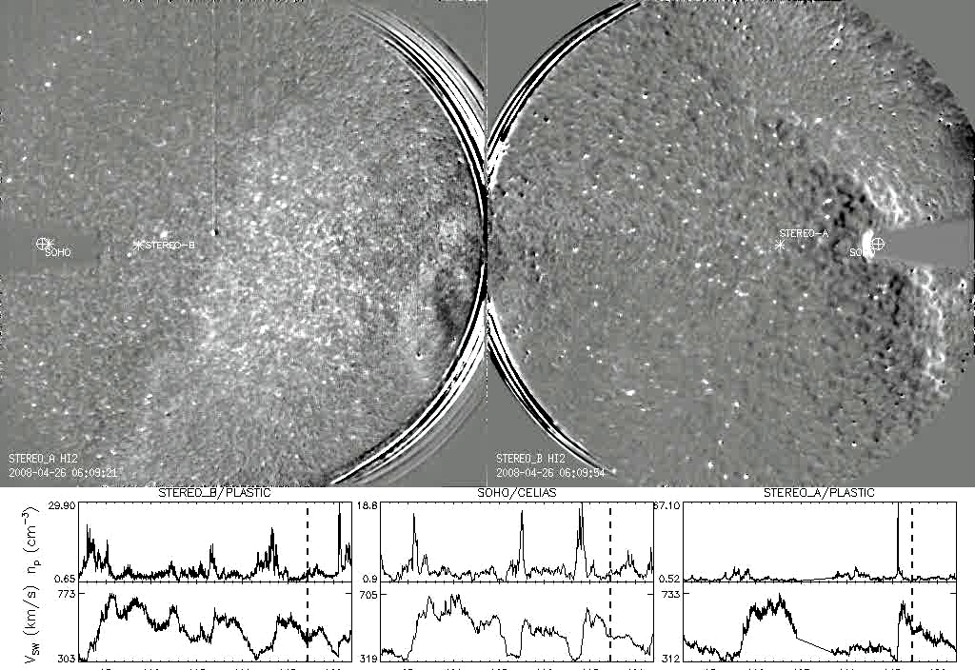
April 26, 2008 CME

Slide 10
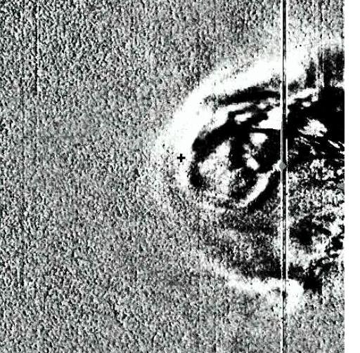
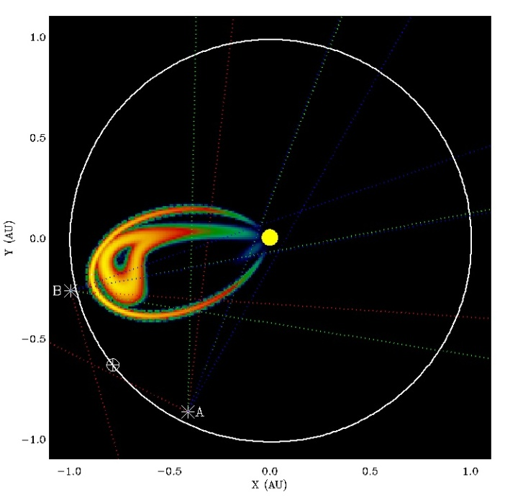
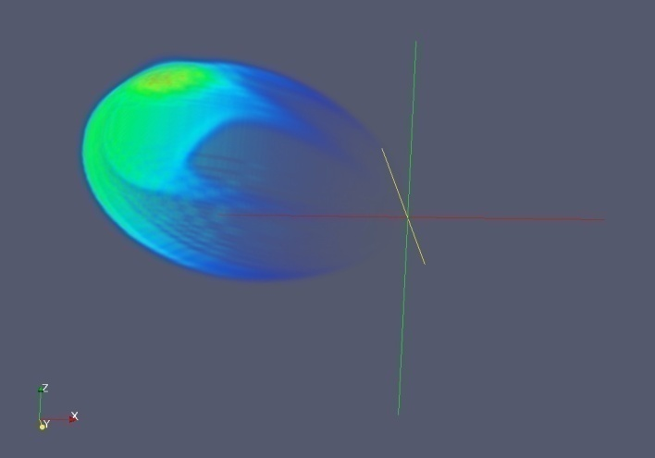
‘Intuitive’ 3D Model of April 26 CME
Results courtesy of Brian Wood

Slide 11
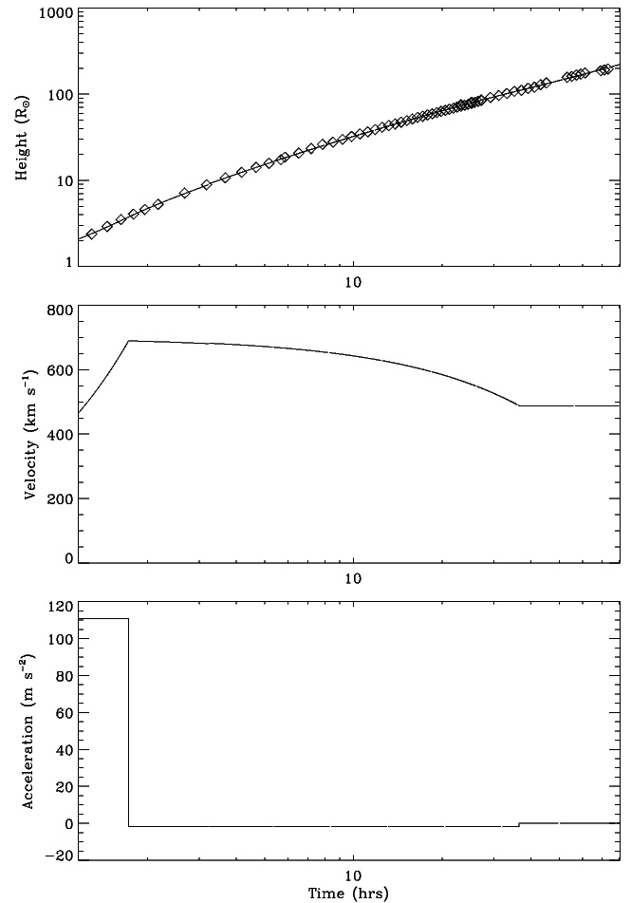
Kinematic Model of April 26 CME
Radial distances r derived from measurements of elongation angles ε using ‘Fixed φ’ assumption:
Kinematic model fit to the CME assumes an initial acceleration phase, followed by a deceleration phase, and finally a constant velocity.
  Fit shown for leading edge of flux rope (not front of CME).
CME reaches STEREO-B around 14:00 UT on April 29.

Slide 12
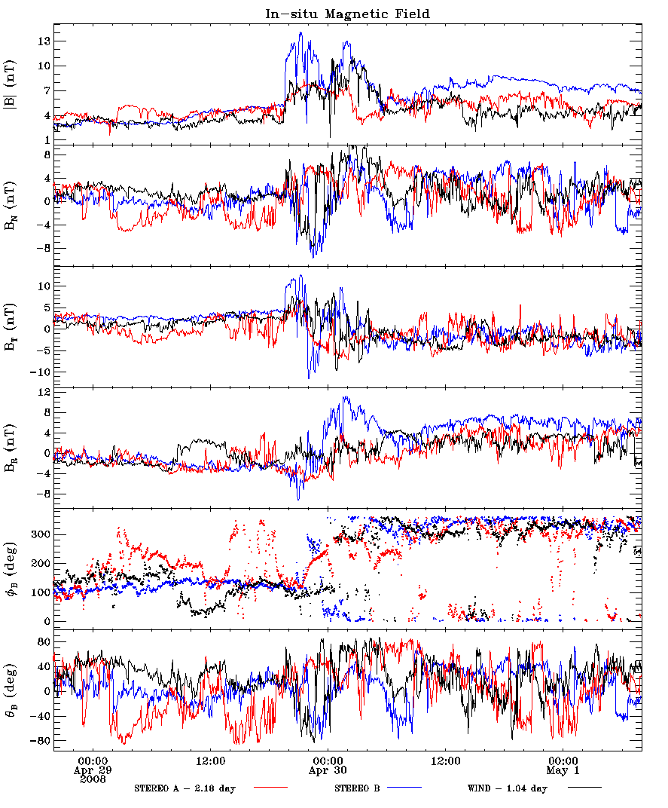
Magnetic Field Observations
Magnetic field for April 29 to May 1, 2008 is shown at STEREO-A (red), STEREO-B (blue) and WIND (black).
  STEREO-A and WIND data have been shifted in time to overlay with STEREO-B.
Magnetic field enhancement with a rapid rotation (~2 hours) is observed in STEREO-B at around the time the CME is expected to arrive at the spacecraft (enhancement is also seen later at WIND and STEREO-A).
However, most plausible interpretation is that the enhancement is caused by a high speed stream pushing into a slow wind structure with the HCS meshed between them.
  Could also be an irregular ejecta?

Slide 13
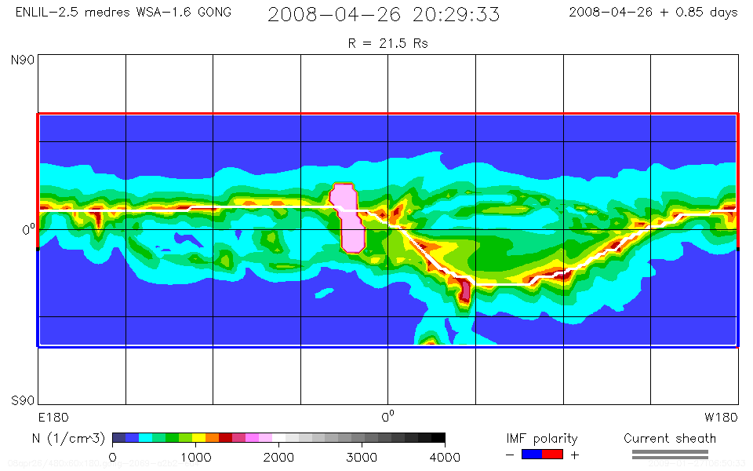
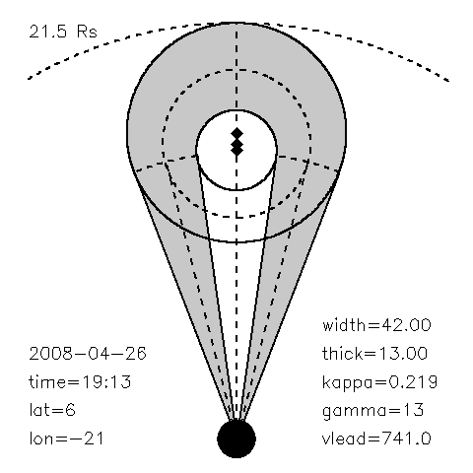
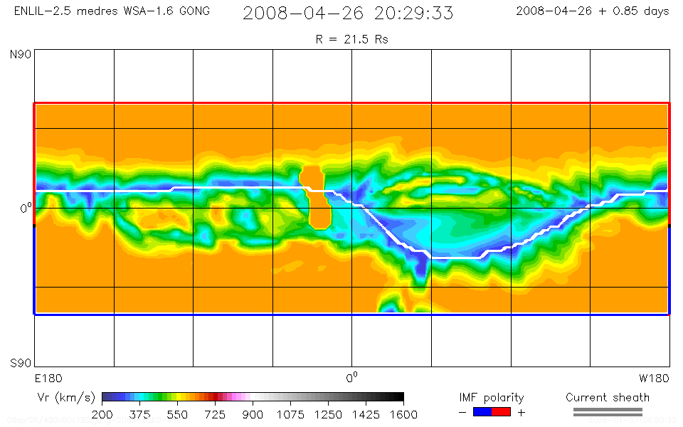
2008 April 26 CME with Rope Model
( Thernisien et al., 2009 )
( WSA-1.6-GONG-CR2069 )

Slide 14
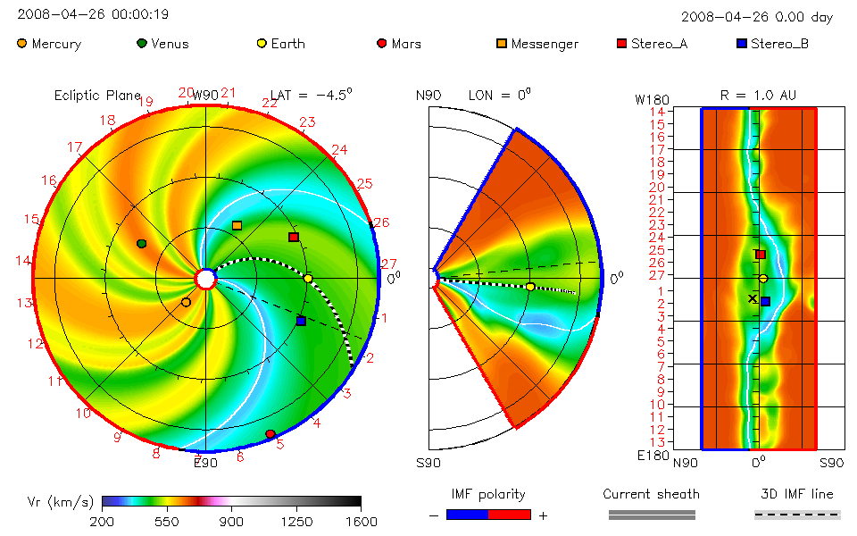
2008 April 26 CME with Rope Model

Slide 15
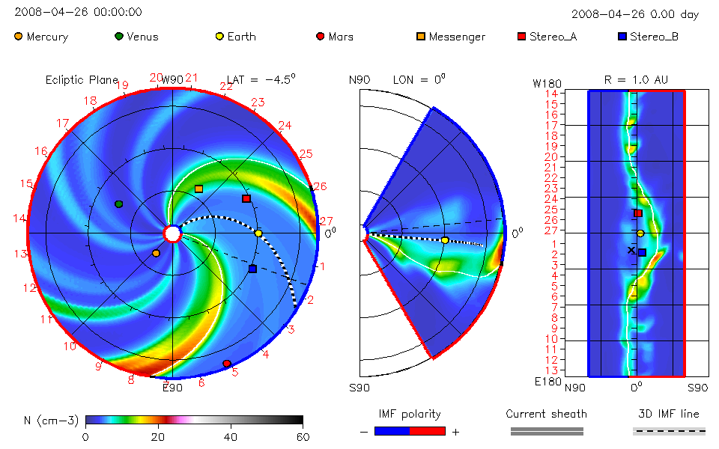
2008 April 26 CME with Rope Model

Slide 16
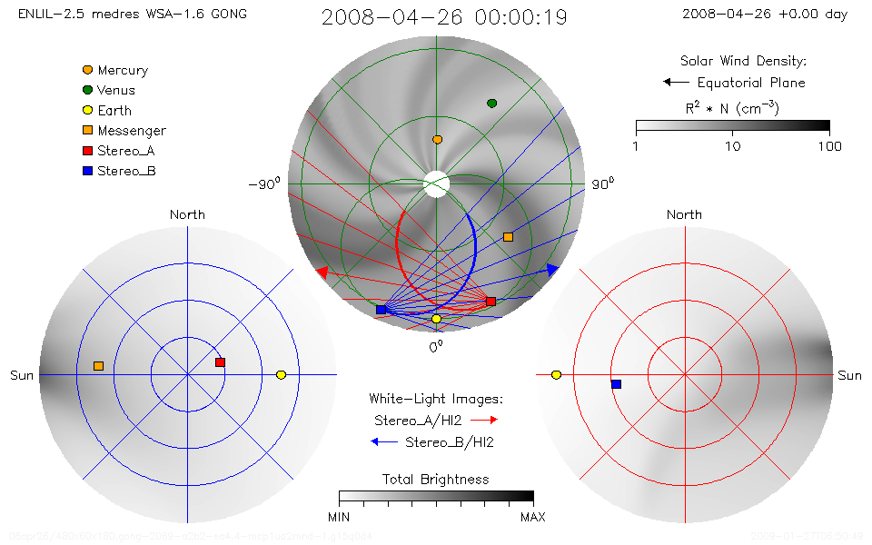
2008 April 26 CME with Rope Model

Slide 17
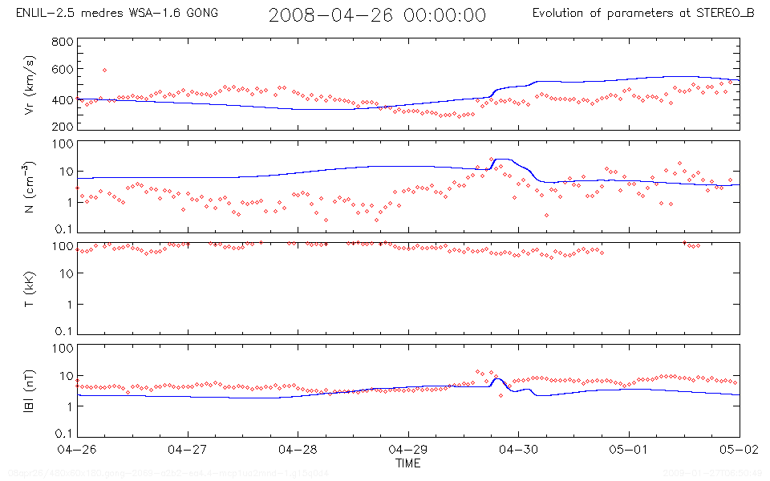
2008 April 26 CME with Rope Model

Slide 18
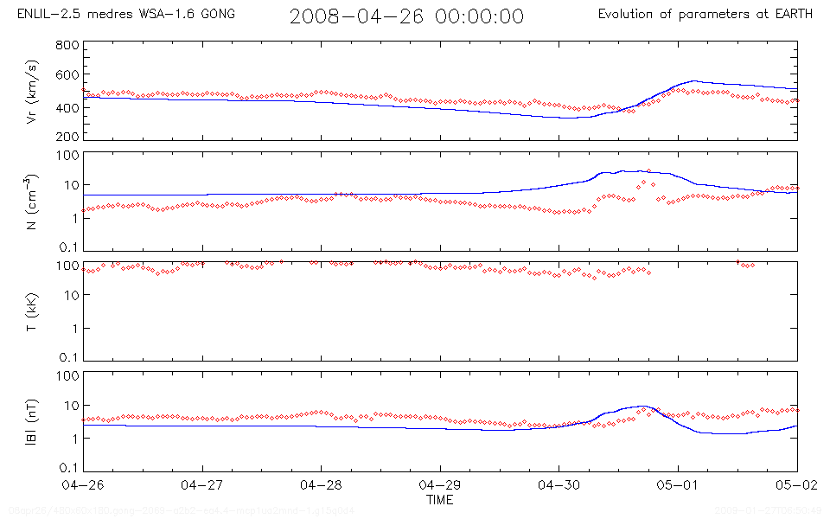
2008 April 26 CME with Rope Model

Slide 19
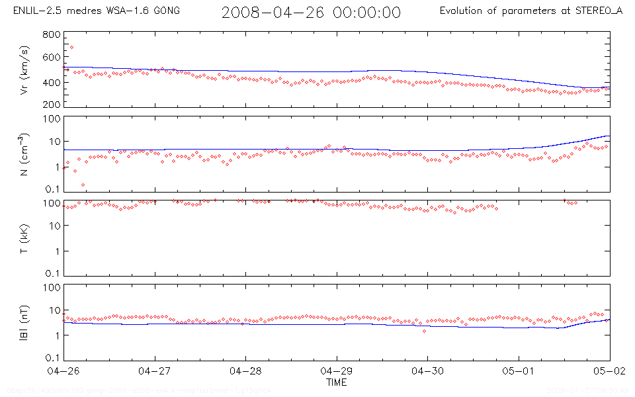
2008 April 26 CME with Rope Model

Slide 20
Coupled Modeling Plans
To fully model and analyze a specific event takes many months of detailed study.
So far, there hasn’t been a ‘perfect’ STEREO CME, given the constraints of:
  Separation of the spacecraft;
  Central disk eruption (as viewed from Earth, i.e. magnetograph observations);
  Coverage from a wide array of observatories;
  Simple, isolated eruption.
From a modeling perspective, the May 2007 event is most ideal.
From an observational perspective, the April and May 2008 events are better (but no clear ICME observed in situ).
Perhaps May 2009 will be kind to us!

Slide 21
Status Summary
Relatively few good events in first year.
Two candidate events have been identified.
  April 26 CME propagates directly towards STEREO-B.
  Density and magnetic field enhancements observed at STEREO-B (and Earth) on April 29, but in-situ observations are more consistent with interaction between high and slow speed streams than with an ICME.
  Timing of in-situ density and magnetic field enhancements is consistent with SECCHI observations and simple geometric and kinematic models of CME propagation.
  Part of May 17 CME propagates towards STEREO-B, but no clear ICME signatures are seen.
  ICME may be embedded in a CIR in one or both cases?
Other events will be considered (e.g. June 2, 2008; January 22, 2009), but ideal event has not yet been observed.
Modeling of candidate events is in early stages.

