Slide 1
Using STEREO/EUVI to Study Active Region Magnetic Fields
Anne Sandman (Rice/LMSAL)
Markus Aschwanden, Jean-Pierre Wuelser,
Marc DeRosa (LMSAL), David Alexander (Rice)
STEREO SWG #19
Pasadena, CA, 4 February 2009

Slide 2
Overview
Objective
Data set
Procedure
Findings and future work

Slide 3
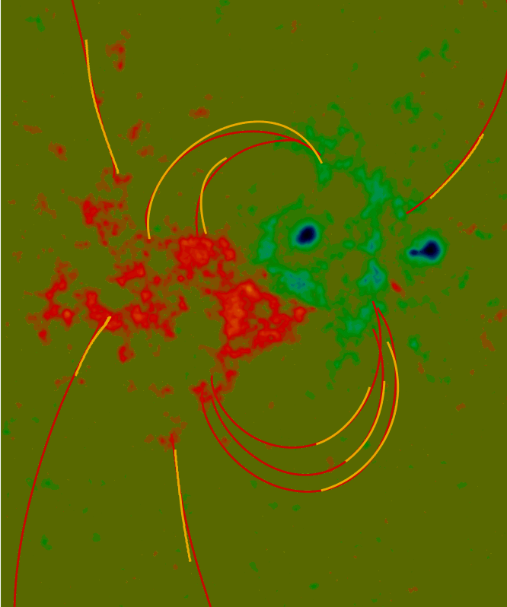
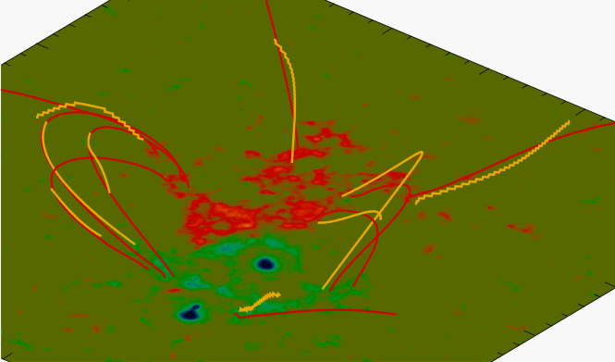
Red: linear force-free field lines (MDI).
Yellow: STEREO loops.
Feng et al. (2007, ApJ 671, L205)

Slide 4
Gary (2007)

Slide 5
Data Set
Three active regions:
AR 10953: 23:00 UT April 30 2007.
AR 10955: 20:30 UT May 9 2007.
AR 10956: 12:40 UT May 19, 2007.
EUVI images in 171, 195, and 284Å.
High-pass filter and boxcar smoothing.

Slide 6
Procedure
Trace loops in EUVI images.
Compute 3D potential magnetic field.
Calculate discrepancy between data and model.
Transform model magnetic field.
Recalculate misalignment angles.

Slide 7
Loop stereoscopy
B
A

Slide 8
Procedure
Trace loops in EUVI images.
Compute 3D potential magnetic field.
Calculate discrepancy between data and model.
Transform model magnetic field.
Recalculate misalignment angles.

Slide 9
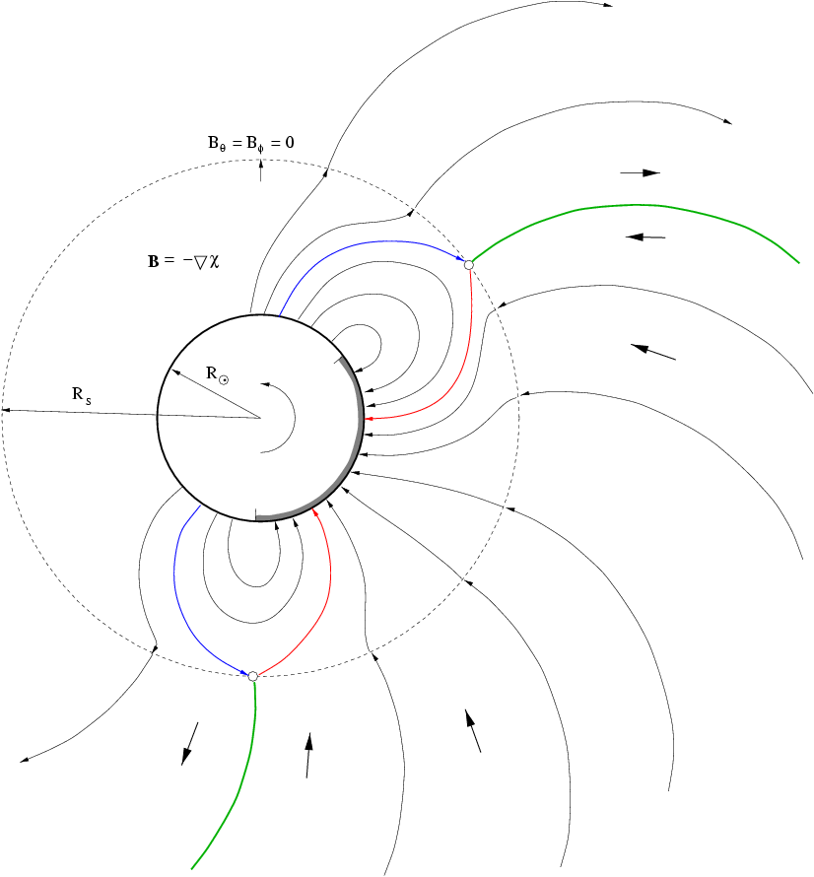
Potential
Field
Source
Surface
Longcope (2005)

Slide 10
Procedure
Trace loops in EUVI images.
Compute 3D potential magnetic field.
Calculate discrepancy between data and model.
Transform model magnetic field.
Recalculate misalignment angles.

Slide 11
Local magnetic field vector
Vector tangent to observed loop
Magnetic field lines
Angle calculation points

Slide 12
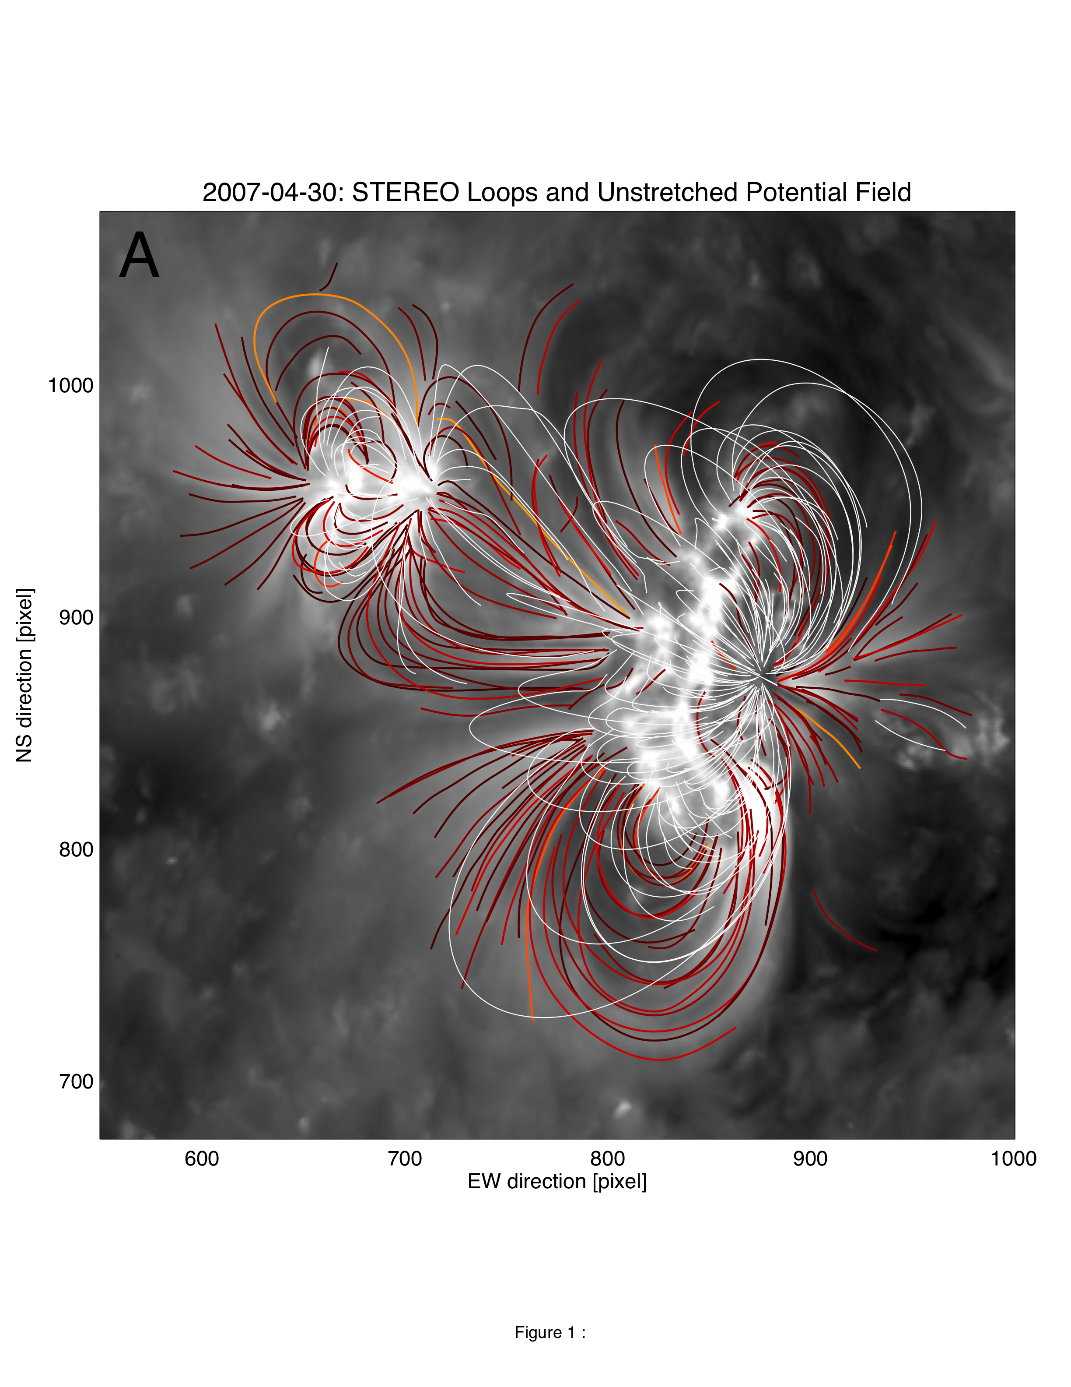
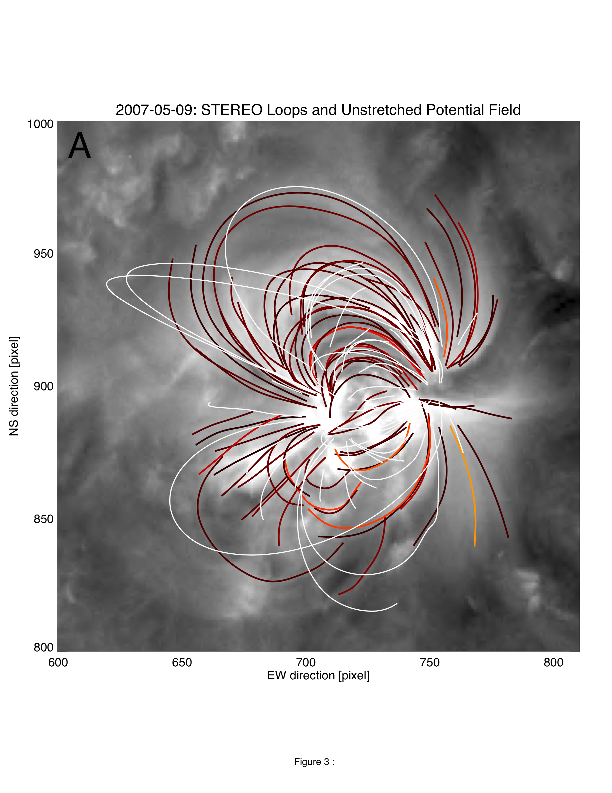
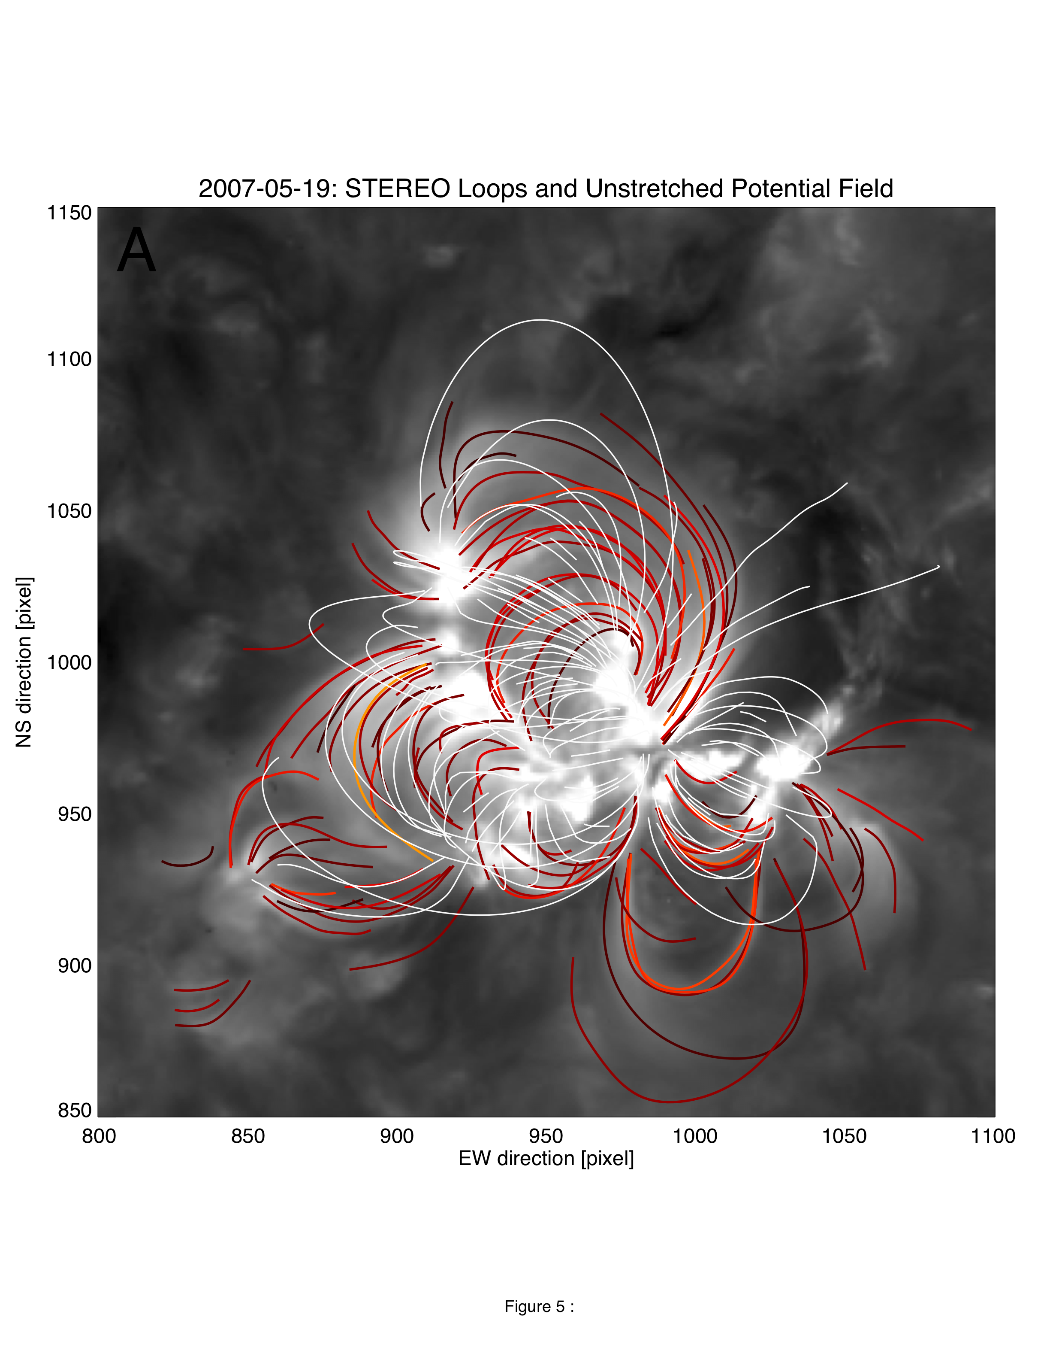
Visualizations

Slide 16
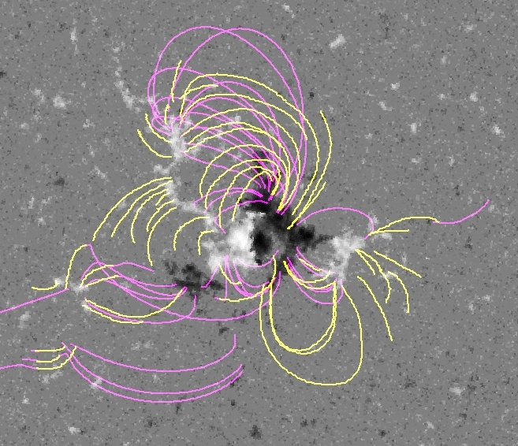
EUVI loops (yellow) and MDI/PFSS field lines (pink) reveal significantly different magnetic connectivities
(courtesy of J.P.Wuelser)

Slide 17
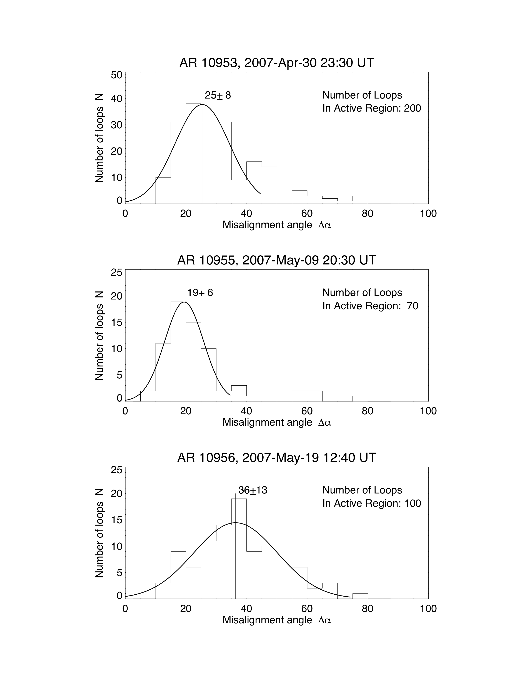
Findings:
AR 10955 (9 May): best agreement with potential field.
AR 10956 (19 May): worst agreement.
NB: AR 10956 produced an eruption within 30 minutes of images.

Slide 18
Procedure
Trace loops in EUVI images.
Compute 3D potential magnetic field.
Calculate discrepancy between data and model.
Transform model magnetic field.
Recalculate misalignment angles.

Slide 19
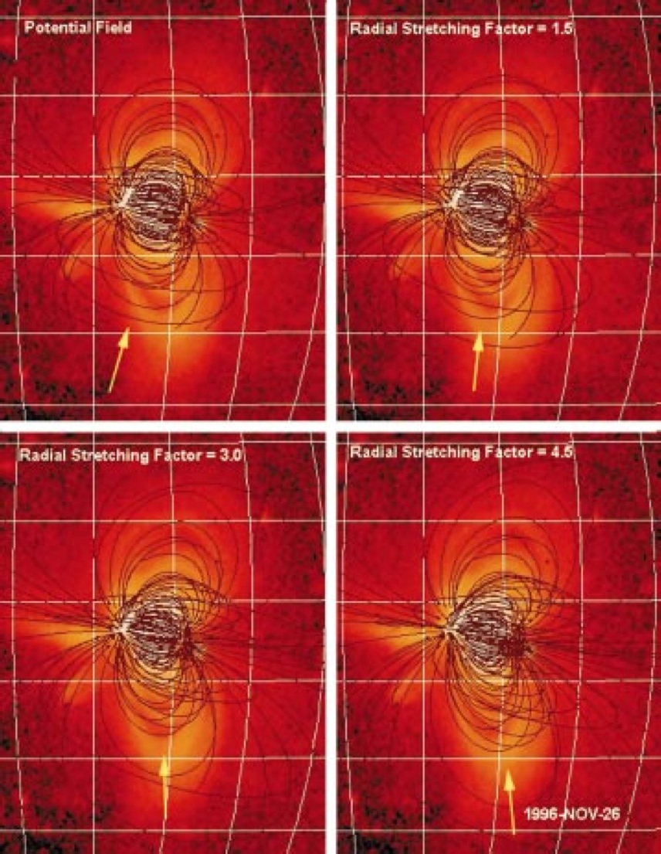
Radial Stretching
Gary & Alexander (1999):
Simple radial stretching improved model’s agreement with observed loop structures.

Slide 20
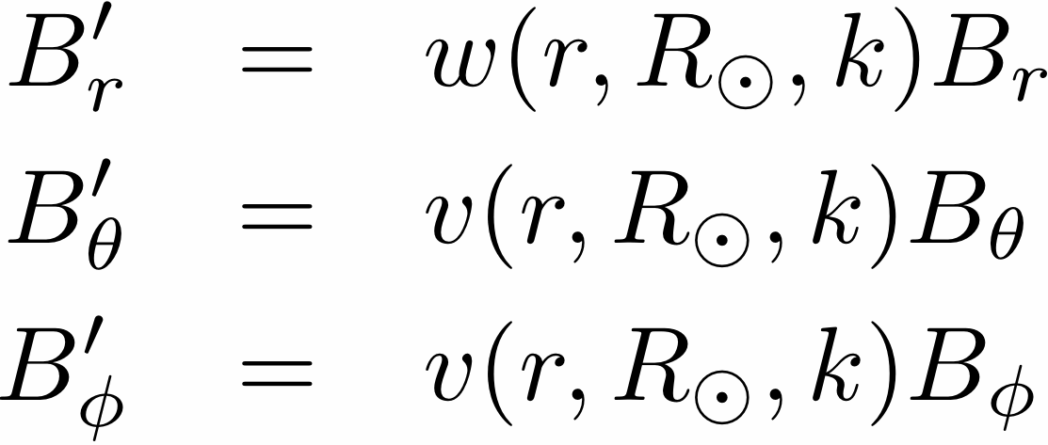
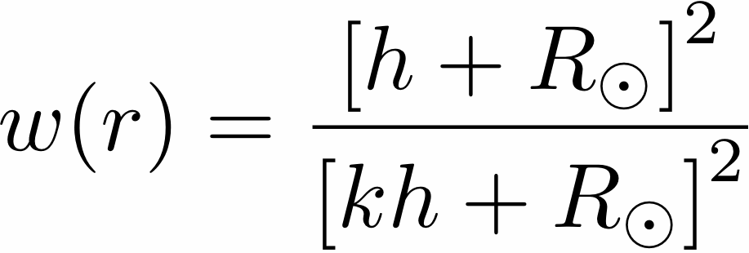
Radial Stretching
Preserves divergence-free condition.
Injects currents.

Slide 21
Procedure
Trace loops in EUVI images.
Compute 3D potential magnetic field.
Calculate discrepancy between data and model.
Transform model magnetic field.
Recalculate misalignment angles.

Slide 22
Conclusions and Future Work
Wide variation in loop-model agreement.
No significant change with radial stretching.
More versatile transformations?
Need more appropriate magnetic field observations.
Use EUVI data to “bootstrap” a better boundary condition.

Slide 25
Conclusions and Future Work
Wide variation in loop-model agreement.
No significant change with radial stretching.
More versatile transformations?
Need more appropriate magnetic field observations.
Use EUVI data to “bootstrap” a better model.

Slide 26
Results of Radial Stretching

