Slide 1
STEREO IMPACT Status
SWG March, 2014
Contributors:
Peter Schroeder, Dave Curtis, Dick Mewaldt Tycho von Rosenvinge, Andreas Klassen, Glenn Mason, Chris Russell, Lan Jian, Benoit Lavraud, Ying Liu, Yan Li, Janet Luhmann

Slide 2
IMPACT Instrument Status Summary
IMPACT’s seven instrument suite has functioned nominally
since the previous SWG, with the exception of a notable MAG
event described below- from which recovery was complete.
MAG experienced a SEL on Feb 20, 2014, on STB which was recovered on Feb 25 (see following slide)
MAG offsets slowly drifting but manageable.
STE-D has been functioning normally.
SWEA has been functioning nominally. The SWEA 3D distribution cadence was changed from 20s to 30s in Nov 2013 in order to reduce total telemetry in anticipation of DSN time shortages in the following months.
SEP suite functioning nominally except for an SEPT latchup on Dec 4, 2013 (recovered) and some elective reprogramming (details below)

Slide 3
Feb 20, 2014, MAG Anomaly on STB
On Feb 20 2014, STB MAG experienced a SEL (single event latchup), which caused the MAG instrument to shut off.
In some respects, this appears similar to the SEU on Jan 8 2011 which caused power down of the full IMPACT and PLASTIC suites by spacecraft autonomy (due to abnormally high current in MAG).
Although instrument and spacecraft houskeeping is too coarse to confirm this, we believe it reasonable that a SEL caused a similarly high current in MAG, and that the hardware responded by shutting down before the spacecraft autonomy rule kicked in.
We recovered MAG through a modified IDPU power cycle procedure on Feb 25 2014. The power cycle allowed the SEP and PLASTIC suites to remain powered.
After the power cycle, PLASTIC was inadvertently put into a silent mode, requiring an IDPU soft reset on Feb 26 2014.

Slide 4
IMPACT Data Report
SWG March 2014
From Peter Schroeder,
with inputs from the IMPACT Team
Notes:
4

Slide 5
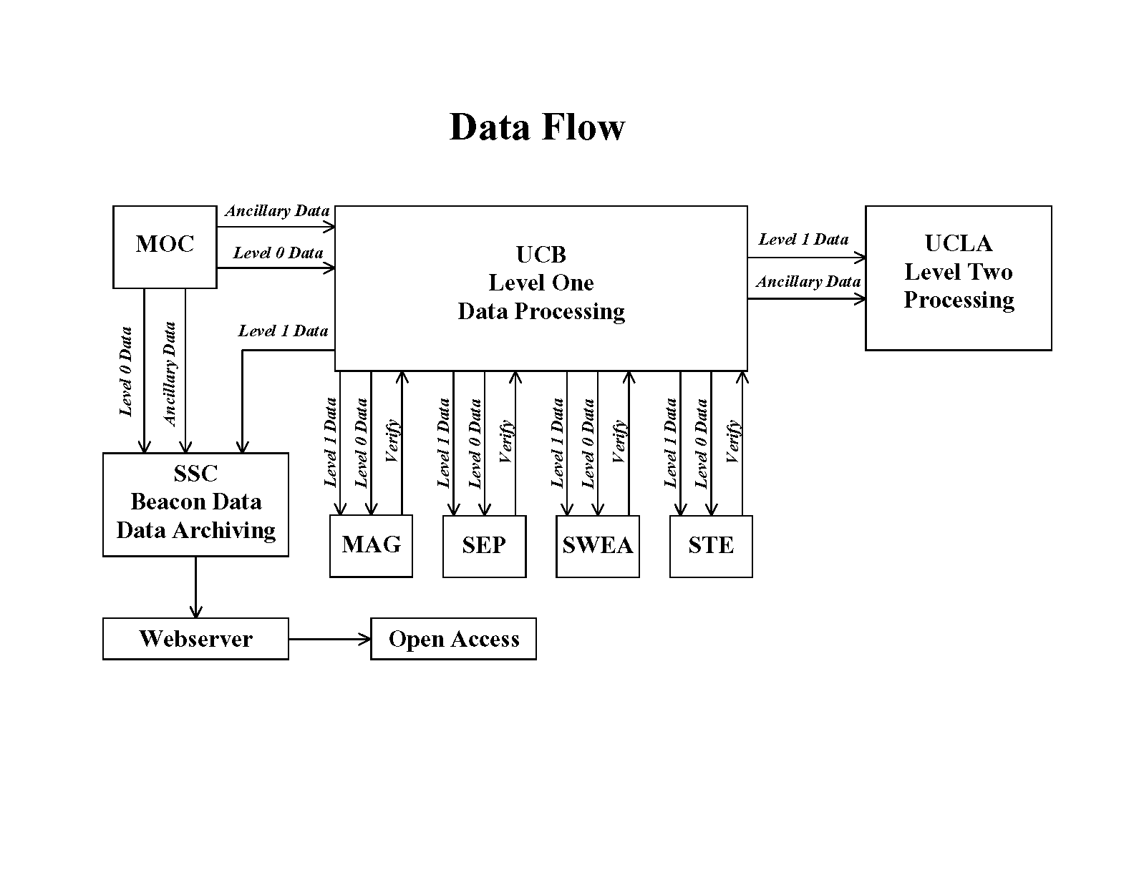
IMPACT Data Flow
(no change)
Caltech
SEP Site
Kiel
SEPT Site
CESR
SWEA Site
Notes:
5

Slide 6
Current IMPACT Level 1 Data Status
Instrument | 1st Date (A) | 1st Date (B) | Last Date
MAG | 2006 Nov 2 | 2006 Nov 2 | 2014 Jan 31
SWEA | 2006 Oct 28 | 2006 Oct 28 | 2014 Jan 31
STE | 2006 Oct 28 | 2006 Oct 28 | 2014 Jan 31
LET | 2006 Nov 14 | 2006 Nov 13 | 2013 Nov 30
SEPT | 2006 Dec 12 | 2006 Dec 12 | 2013 Sep 30
SIT | 2007 Mar 15 | 2007 Mar 15 | 2014 Jan 31
HET | 2006 Dec 1 | 2006 Nov 14 | 2013 Jul 31
Notes:
6

Slide 7
Data Processing Time
Time delay to data appearance on the website has been nominal
  IMPACT (and the rest of STEREO) does not receive “final” Level 0 telemetry files until 30 days after any given date.
  Our Co-I’s generally like to validate data one month at a time. This means, for example, that they won’t begin validation of January data until the beginning of March.
  Then it requires a couple of weeks or more to validate.
7
Notes:
7
7

Slide 8
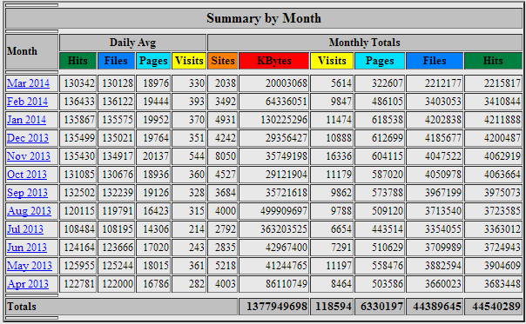
Updated IMPACT website/data access@UCB
Notes:
8

Slide 9
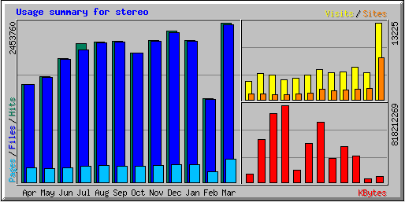
IMPACT website/data access@UCB at prior SWG
Notes:
9

Slide 10
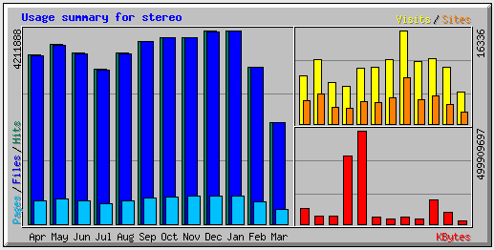
IMPACT website/data access@UCB update (indicates increased use)

Slide 11
SEP Suite Status
STEREO SWG
3/21/2014

Slide 12
STEREO HET STATUS
Tycho von Rosenvinge, March 18, 2014
Operations:
• Both HET sensors continue normal operation
Data Processing and Accessibility:
• HET data from both STA and STB are processed and available through 3/18/2014
Plans for the Conjunction:
• Once either HET is turned off it should remain off until it can be turned on and remain on

Slide 13
STEREO HET PROGRESS
Extensive paper in press (Solar Physics):
“>25 MeV Proton Events Observed by the High Energy Telescopes on the STEREO A and B Spacecraft and/or at the Earth During the First ~Seven Years of the STEREO Mission”,
Richardson, von Rosenvinge, et al.
Contains a table of details for 209 SEP events:
  spacecraft locations
  intensities of ~25 MeV protons at each spacecraft
  solar event longitude
  CME, X-ray flare, and radio burst properties
This table will be put on-line at the Caltech STEREO website soon.

Slide 14
STEREO/LET Status
Richard Mewaldt - 3/21/14
Operations:
• Both LET Instruments continue normal operation and performance
Data Processing and Availability:
• Data from both LET sensors have been processed and made available through Jan. 31, 2014
Reductions in Bit Rate:
• Early in 2013 both LET sensors reduced their bit rates by a significant amount (see summary below)
Plans for the Conjunction:
• Once either LET sensor is turned off we would like it to remain off until it can be turned on and remain on

Slide 15
SIT Status report
Glenn Mason JHU/APL 3/11/2014
SIT status report 3/2014
SEP central patches to drop empty SIT PHA packets (Feb, Mar 2013)
Instrument operating status:
  SIT-A and SIT-B both operating nominally
  last table uploads: 4/2011 and 5/2011; no changes since then
  possible degradation of MCP efficiency due to solar activity is being monitored; correction, if any, will be done in on-ground software
Data processing status:
most recent data to Caltech site:
  ASCII files through 2014 Jan 29 (use .fin files)
  browse plots through 2014 Mar 10
  L1 data released through Berkeley site through Sept 2013 (released 11/15/2013)
Plans for conjunction period: seek to minimize HV cyclings, and thermal excursions; prefer to be off rather than cycle instrument

Slide 16
SEPT Status Report
Andreas Klassen CAU/Kiel 2014-03-11
-
1. Instrument issues:
On 04-Dec-2013 07:33 UT SEPT-N on STA experienced a latch-up.
Affected were the SEPT-North electron telescope and the SEPT-South ion telescope.
The instrument was restored back to nominal mode on 11-Dec-2013 at 15:55 UT.
Otherwise all telescopes are operating in normal mode.
2. Status of Data processing:
–Verified level 2 ASCII files available online through October 9, 2013:
http://www2.physik.uni-kiel.de/stereo/data/sept/level2/
–SEPT browse plots available online through March 1, 2014:
http://www2.physik.uni-kiel.de/stereo/browseplots/
3. Plans for the Conjunction period:
SEPT team suggests that their instrument can be powered on every three
days to record data during the solar conjunction, presenting the opportunity
to inter-calibrate the instruments (STA vs. STB). (my note: SEPT has not participated
in the recent SEP group discussions on the power cycling issues so this is a
unique perspective on the matter among the SEP group).

Slide 17
SEP-Suite Reductions in Bit-Rate
During February 2013 we uploaded patches to the LET and SEP-Central flight software on both Ahead and Behind that reduces the science telemetry from the LET and SIT instruments during solar quiet times. During solar events, up to the full science telemetry allocation will still be telemetered. The new flight software filters out "livetime-stim" PHA calibration events from LET, and any empty PHA packets from SIT. These changes do not affect the science from these instruments.
During a 40-day period starting 2013 Oct 27, these changes reduced the TOTAL telemetry from the SEP suite of instruments on Ahead by ~28% compared with the same period in previous years. This period is free of data gaps.
During solar quiet times the telemetry reduction is ~46%

Slide 18
STEREO MAG status in 2013
The changes of zero level over the last year are within 1 nT for all three components in both STA and STB.
Decline in burst model data: data up to doy 009
  STA: 5 to 25 minutes data recorded in 6 days
  STB: 35 to 145 minutes data recorded in 9 days
Data production:
  At the end of the month we wait 30 days and download one month of data (to allow the files to be finalized at APL) and process the month as quickly as possible (about 2 weeks). So generally we are never more than 2.5 months behind real time.

Slide 19
Supplementary Data Report
(from Lan Jian, UMD)
Update on Level 3 event lists at UCLA/STEREO site
  Lists of interplanetary coronal mass ejections, stream interaction regions, and interplanetary shocks are updated to 12/31/2012 for both s/c. Lan Jian has started the survey of 2013 events, will continue working on it and update it soon
  List of solar energetic particle events from HET is updated to 9/30/2013 for both s/c

Slide 20
Selected IMPACT Science Updates
(all)

Slide 21
Statistics of STEREO In-situ Events through 2012 showing activity increase (L.K. Jian)
(SIR)

Slide 22
Comparison with ICME statistics of previous cycle (L1 data) (L.K. Jian)
In comparison with solar max 23
similar amount of ICMEs
lower shock rate and size
slower propagation speed
weaker maximum magnetic field

Slide 23
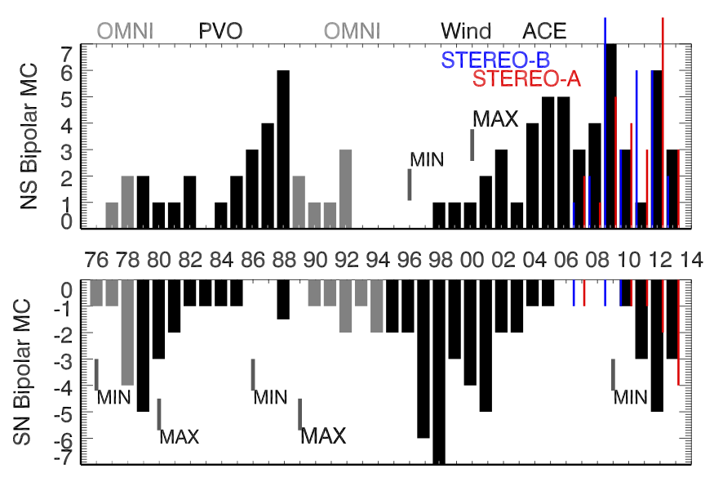
Update on Solar Cycle ICME Magnetic ‘Polarities’ (Yan Li, SSL)

Slide 24
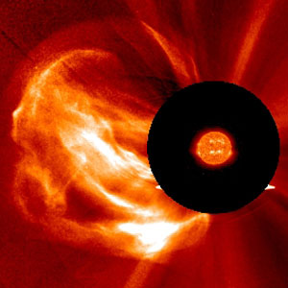
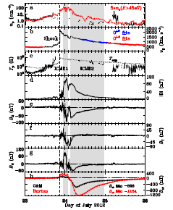
Recent Nature Communications | Article
Observations of an extreme storm in interplanetary space
caused by successive coronal mass ejections
..Attributes importance of the July 2012 STA event to a combination of multiple
coronal eruptions from the same region, including an earlier one that cleared
out the space ahead.
Ying Liu
Other Coauthors:
Janet G. Luhmann,
Primož Kajdič,
Emilia K.J. Kilpua,
Noé Lugaz,
Nariaki V. Nitta,
Christian Möstl,
Benoit Lavraud,
Stuart D. Bale,
Charles J. Farrugia
& Antoinette B. Galvin
  Nature Communications 5, doi:10.1038/ncomms4481,
  18 March 2014
Their ‘Featured Image’

Slide 25
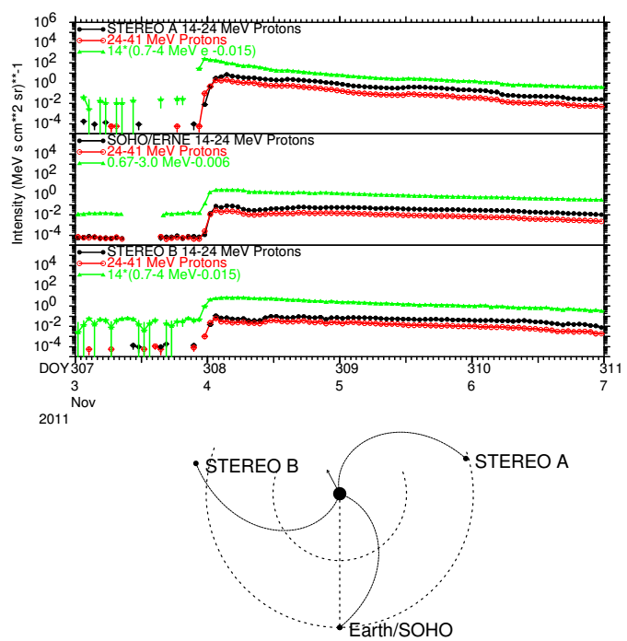
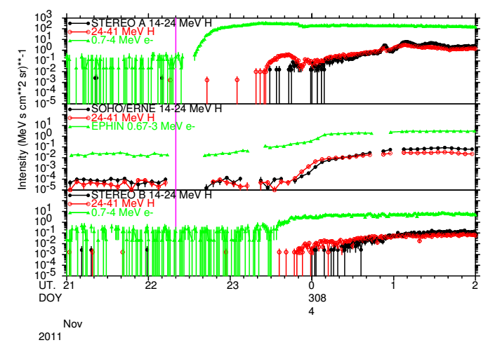
November 3, 2011: Rapid Onset at all Three Spacecraft
In this expanded view of event onset, the vertical purple line indicates the time of type III burst onset. 0.7-4 MeV electrons arrived at STEREO A ~13 minutes later, followed by 24-41 MeV protons ~52 minutes later. Similar energy protons were observed at the other two S/C after an additional delay of only ~25 minutes. Thus, within ~90 minutes of event onset, ~25 MeV protons were detected throughout the inner heliosphere.
This unusual event shows a rapid rise at all S/C, even at Earth for which the event was at E152º. As might be expected, the intensity was largest at the best connected S/C (STEREO A). A (not particularly fast) 991 km/s halo CME was observed by LASCO.

Slide 26
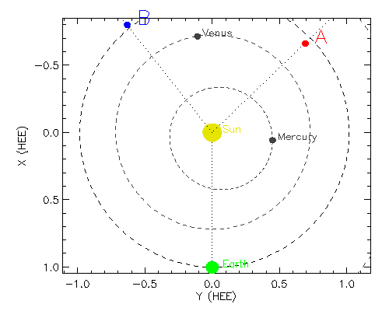
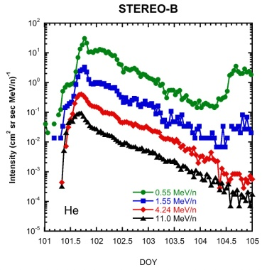
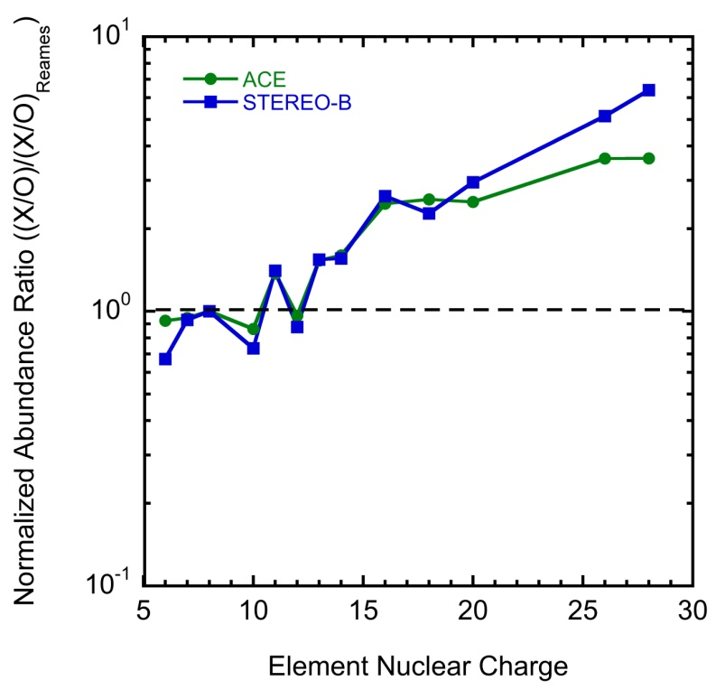
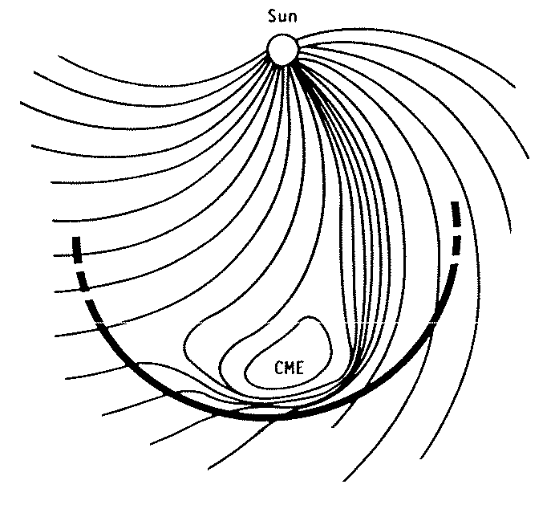
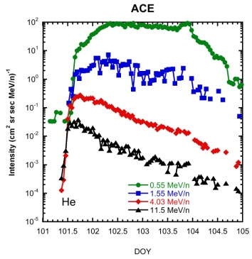
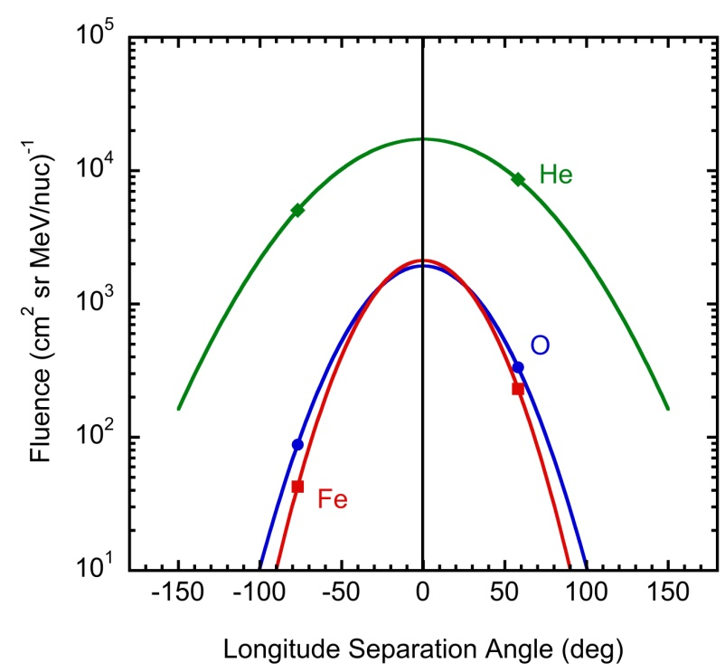
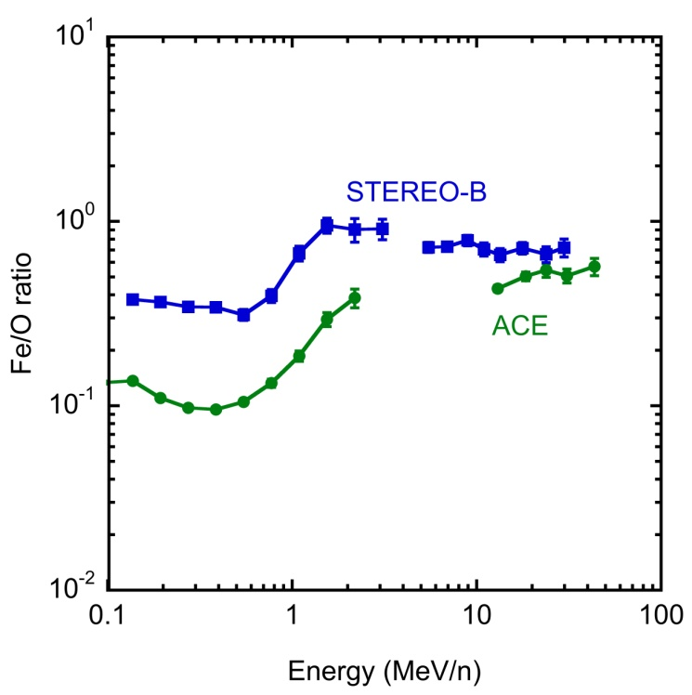
The First Large Fe-rich SEP Event of Cycle 24
Heavy ions from the 11 April 2013 SEP event were observed by STEREO-B and ACE
Both spacecraft observed SEP composition enriched in Fe and other heavy ions
The enrichment in Fe is energy dependent, similar to cycle 23 Fe-rich events
STEREO-B
and ACE were separated by 142°
σ_{He} = 49°
σ_{O} = 38°
σ_{Fe} = 31°
The He longitude distribution is
wider than O which is wider
than Fe
This suggests Fe/O ~1 for
positions magnetically
connected to the flare site,
consistent with a direct flare
contribution
Or quasi-perp shocks on the
flanks of the CME could
cause the high Fe/O ratios at STB &ACE

Slide 27
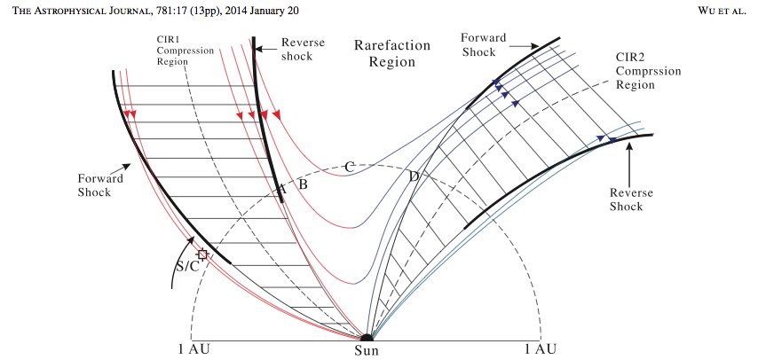
SIT Science nugget:
An unusual event in CR 2060 showed 2 CIRs separated by less than 5 days where the maximum intensities of the energetic particles was not at the CIR passages, but rather in the period between the CIRs. Anisotropies observed during this period as well as IMF data suggest that this was caused by a U-shaped large scale topology that connected the reverse shock of the first CIR to the forward shock of the 2nd CIR, creating a region where particle acceleration led to higher intensities. This U-shaped region may have been formed by reconnection in the upper corona. (Wu et al., ApJ, 781, 17, 2014)

Slide 28
STEREO HET –
Some Findings
Between December, 2009 and December, 2012, 36% of events were seen at only 1 spacecraft, 34% were seen at 2 spacecraft, and 17% were seen at 3 spacecraft
Even moderate events are sometimes visible at widely-spread solar longitudes
Electron and proton transport processes are highly coupled
There are occasional challenging events in which ~25 MeV protons fill the inner heliosphere remarkably rapidly
SEP events, when divided according to North and South hemisphere, show signs of a periodicity of ~ 150 days

Slide 29
ACE/STEREO/Wind In Situ Science Workshop
April 2 - 3, 2014 Caltech, Pasadena CA Spitzer Science Center
An ACE/STEREO/Wind In Situ Science Workshop will be held April 2 - 3, 2014 at Caltech's Spitzer Science Center in Pasadena, CA.
The Workshop will allow members of the ACE, STEREO and Wind science teams (and selected other invitees) to make science presentations, discuss possible joint projects, and address other programmatic issues.
Meeting Organizers
This meeting is being organized by
Richard Mewaldt - Caltech rmewaldt@srl.caltech.edu
Janet Luhmann - UC Berkeley jgluhman@ssl.berkeley.edu
Adam Szabo - GSFC adam.szabo-1@nasa.gov
Lynn Wilson - GSFC lynn.b.wilsoniii@gmail.com

Slide 30
STEREO IMPACT Team-Publications (1)
2013-14
L.K. Jian, C.T. Russell, J.G. Luhmann, D. Curtis, P. Schroeder, Burst Mode Trigger of STEREO In Situ Measurements, Amer. Inst. Phys. Proceedings of Solar Wind 13, 1539, 195-198, doi: 10.1063/1.4811021, 2013.
L.K. Jian, C.T. Russell, J.G. Luhmann, A.B. Galvin, K.D.C. Simunac, Solar Wind Observations at STEREO: 2007 – 2011, Amer. Inst. Phys. Proceedings of Solar Wind 13, 1539, 191-194, doi: 10.1063/1.4811020, 2013.
A.B. Galvin, K.D.C. Simunac, L.K. Jian, C.F. Farrugia, M.A. Popecki, Solar Wind Ion Observations: Comparison from the Depths of Solar Minimum to the Rising of the Cycle, Amer. Inst. Phys. Proceedings of Solar Wind 13, 1539, 15-18, doi: 10.1063/1.4810978, 2013.
O. Enriquez-Rivera, X. Blanco-Cano, C.T. Russell, L.K. Jian, J.G. Luhmann, K.D.C. Simunac, A.B. Galvin, Mirror-Mode Storms inside Stream Interaction Regions and in the Ambient Solar Wind: A Kinetic Study, J. Geophys. Res., 118, 17-18, doi: 10.1029/2012JA018233, 2013.
X. Blanco-Cano, P. Kajdič, E. Aguilar-Rodríguez, C.T. Russell, L.K. Jian, J.G. Luhmann, STEREO Interplanetary Shocks and Foreshocks, Amer. Inst. Phys. Proceedings of Solar Wind 13, 1539, 131-134, doi: 10.1063/1.4811005, 2013.
T. Nieves-Chinchilla, A. Vourlidas, G. Stenborg, N.P. Savani, A. Koval, A. Szabo, L.K. Jian, Inner Heliospheric Evolution of a “Stealth” CME Derived from Multi-view Imaging and Multipoint In-situ Observations: I. Propagation to 1 AU, The Astrophys. J., 779, 55, doi: 10.1088/0004-637X/779/1/55, 2013.

Slide 31
STEREO IMPACT-Team Publications (2) 2013-14
P. Kajdič, X. Blanco-Cano, A. Opitz, J.-A. Sauvaud, E. Aguilar-Rodriguez, C.T. Russell, J.G. Luhmann, L.K. Jian, A.P. Rouillard, B. Lavraud, Electron Distributions Upstream and Downstream of ICME Driven IP Shocks, Amer. Inst. Phys. Proceedings of Solar Wind 13, 1539, 203-206, doi: 10.1063/1.4811023, 2013.
D.F. Webb, C. Möstl, B.V. Jackson, M.M. Bisi, T.A. Howard, T. Mulligan, E.A. Jensen, L.K. Jian, J.A. Davies, C.A. de Koning, Y. Liu, M. Temmer, J.M. Clover, C.J. Farrugia, R.A. Harrison, N. Nitta, D. Odstrcil, S.J. Tappin, H.-S. Yu, Heliospheric Imaging of 3D Density Structures During the Multiple Coronal Mass Ejections of Late July to Early August 2010, Solar Phys., 285, 317-348, doi: 10.1007/s11207-013-0260-5, 2013.
J.A. Barry, A.B. Galvin, M. Popecki, B. Klecker, H. Kucharek, K. Simunac, C.J. Farrugia, J.G. Luhmann, L.K. Jian, Analysis of Suprathermal Proton Events Observed by STEREO/PLASTIC Focusing on the Observation of Bow Shock/Magnetospheric Events, Amer. Inst. Phys. Proceedings of Solar Wind 13, 1539, 382-385, doi: 10.1063/1.4811065, 2013.
L.K. Jian, H.Y. Wei, C.T. Russell, J.G. Luhmann, B. Klecker, N. Omidi, P. Isenberg, M.L. Goldstein, A. Figueroa-Viñas, X. Blanco-Cano, Electromagnetic Waves near the Proton Cyclotron Frequency: STEREO Observations, The Astrophys. J., submitted, 2013.
Y. C.-M. Liu, J. Huang, C. Wang, B. Klecker, A.B. Galvin, K.D.C. Simunac, M.A. Popecki, L. Kistler, C. Farrugia, M.A. Lee, H. Kucharek, A. Opitz, J.G. Luhmann, L. Jian, A Statistical Analysis of Heliospheric Plasma Sheet, Heliospheric Current Sheet and Sector Boundary Observed in situ by STEREO, J. Geophys. Res., in press, 2014.

Slide 32
STEREO IMPACT-Team Publications (3)
2013-14
Cohen, C. M. S., G. M. Mason, R. A. Mewaldt, and T. T. von Rosenvinge, “Solar Energetic Particle Characteristics and their dependence on longitude in solar cycle 24”, in Solar Wind 13, G. P. Zank, et al. eds, AIP Conference Proceedings #1539 (Melville, NY), 151-154 (2013).
Cohen, C. M. S., M. E. Wiedenbeck, G. M. Mason, R. Gomez-Herrero, D. K. Haggerty, N. V. Nitta, Furthering Our Understanding of Wide Longitude 3He-rich SEP Events, Proc. of 33rd ICRC, 2013.
Leske, R.A., Cohen, C.M.S., Dotson, B., Mewaldt, R.A., Cummings, A.C., Labrador, A.W., Stone, E.C., Wiedenbeck, M.E., Christian, E.R., and von Rosenvinge, T.T., "A Survey of Anisotropic Energetic Particle Flows Observed by STEREO", in Solar Wind 13, edited by G.P. Zank et al. (American Institute of Physics), AIP Conf. Proc. #1539, 227-230 (2013).
Leske, R.A., Cohen, C.M.S., Mewaldt, R.A., Cummings, A.C., Labrador, A.W., Stone, E.C., Wiedenbeck, M.E., Christian, E.R., and von Rosenvinge, T.T., "Solar Energetic Particle Anisotropies Observed by STEREO/LET", Proc. 33rd Internat. Cosmic Ray Conf. (Rio de Janeiro), paper 0583 (2013).
Mewaldt, R. A., C. M. S. Cohen, G. M. Mason, T. T. von Rosenvinge, R. A. Leske, J. G. Luhmann, D. Odstricil, and A. Vourlidas, “Solar Energetic Particle Events and their Variability from the Sun and Beyond”, in Solar Wind 13, G. P. Zank, et al. eds, AIP Conference Proceedings #1539 (Melville, NY), 116-121, (2013).
Mewaldt, R. A., C. M. S. Cohen, G. M. Mason, T. T. von Rosenvinge, R. A. Leske, J. G. Luhmann, “A 360° View of Solar Energetic Particle Events, Including One Extreme Event”, Proc. 33rd Internat. Cosmic Ray Conf. (Rio de Janeiro), paper 1186 (2013).
Russell, C. T., R. A. Mewaldt, J. G. Luhmann, G. M. Mason, T. T. von Rosenvinge, C. M. S. Cohen, R. A. Leske, R. Gomez-Herrero, A. Klassen, A. B. Galvin, and K. D. C. Simunac, “The Very Unusual Interplanetary Coronal Mass Ejection of July 23, 2012: A Blast Wave Mediated by Solar Energetic Particles”, Astrophys. J., 770:38, doi:10.1088/0004-637X/770/1/38, June 2013.

Slide 33
STEREO IMPACT-Team Publications (4)
2013-14
Wiedenbeck, M. E., and G. M. Mason, The Solar Cycle Variation of 3He from Solar Energetic Particle Events”, Proc. 33rd Internat. Cosmic Ray Conf. (Rio de Janeiro), paper 971 (2013).
Wiedenbeck, M. E. , G. M. Mason , C. M. S. Cohen, N. V. Nitta, R. G´omez-Herrero, and D. K Haggerty, “Observations of Solar Energetic Particles from 3He-rich Events over a Wide Range of Heliographic Longitude”, The Astrophysical Journal, 762:54 (9pp), 2013.
Cohen, C. M. S., G. M. Mason, R. A. Mewaldt, and M. E. Wiedenbeck, “The Longitudinal Dependence of Heavy Ion Composition in the 11 April 2013 SEP Event”, submitted to The Astrophysical Journal, 2014.
Cohen, C.M.S., R.A. Mewaldt, G.M. Mason, The Charge-to-Mass Dependence of SEP Fluences Over Wide Longitudes, in Outstanding Problems in Heliophysics: From Coronal Heating to the Edge of the Heliosphere, Proc. of 12th Annual Internat. Astrophysics Conf., edited by Q. Hu and G.P. Zank, (Astronomical Society of the Pacific), ASP Conf. Proc. #484, 118-123 (2014). in press 2014.
Leske, R.A., Cummings, A.C., Cohen, C.M.S., Mewaldt, R.A., Labrador, A.W., Stone, E.C., Wiedenbeck, M.E., Christian, E.R., and von Rosenvinge, T.T., "Observations of Loss-Cone Pitch Angle Distributions of Solar Energetic Particles", in Outstanding Problems in Heliophysics: From Coronal Heating to the Edge of the Heliosphere, Proc. of 12th Annual Internat. Astrophysics Conf., edited by Q. Hu and G.P. Zank, (Astronomical Society of the Pacific), ASP Conf. Proc. #484, 118-123 (2014).
Papaioannou, A., O. E. Malandraki, N. Dresing, B. Heber, K.-L. Klein, R. Vainio, T. Rodrigues-Gasen, A. Klassen, A. Nindos, D. Heynderickx, R. A. Mewaldt, R. Gomez-Herrero, N. Vilmer, A. Kouloumvakos, K. Tsiotsiou, and G. Tsiropoula, “SEPServer Catalogues of Solar Energetic Particle events at 1 AU based on STEREO recordings: 2007-2012”, Astronomy and Astrophysics, in press, (2014).
Richardson, I. G., T. T. von Rosenvinge, H. V. Cane, E. R. Christian, C. M. S. Cohen, A. W. Labrador, R. A. Leske, R. A. Mewaldt, M. E. Wiedenbeck, and E. C. Stone, “>25 MeV Proton Events Observed by the High Energy Telescopes on the STEREO A and B Spacecraft and/or at the Earth During the First Seven Years of the STEREO Mission”, submitted to Solar Physics, 2014.
Wu. Z., Y. Chen, G. Li, L. L. Zhao, R. W. Ebert, M. I. Desai, G. M. Mason, B. Lavraud, L. Zhao, Y C. -M Liu, F. Guo, C. L. Tang, E. Landi, and J. Sauvaud, “Observations of Energetic Particles Between a Pair of Corotating Interaction Regions”, Astrophys. J., 781:17, doi: 10.1088/0004-637X/781/1/17, Jan., 2014

Slide 34
STEREO IMPACT-Team Publications (5)
2013-14
Vainio, R., E. Valtonen, B. Heber, etal., The first SEPServer event catalogue 68-MeV solar ̃ proton events observed at 1 AU in 1996-2010. Journal of Space Weather and Space Climate, 3(26):A260000, Mar. 2013.
Dresing, N. C. Cohen, R. Gomez-Herrero, B. Heber, A. Klassen, R. Leske, G. Mason, R. Mewaldt, and T. von Rosenvinge, Approaching solar maximum 24 with STEREO Multi-point observations of solar energetic particle events,In ICRC 2013, Rio de Janeiro, Brazil, 2013.
Dresing, N.R. Gomez-Herrero, A. Klassen, B. Heber, O. Malandraki, W. Droge, andY. Karatavykh, A statistical analysis of wide-spread SEP events observed with STEREO and close to Earth spacecraft, In ICRC 2013, Rio de Janeiro, Brazil, 2013.
Heber,B., N. Dresing, W. Droge, R. Gomez-Herrero, K. Herbst, Y. Kartavykh, A. Klassen, J. Labrenz, and O. Malandraki, The first ground level event of solar cycle 24 and its longitudinal distribution in the inner heliosphere,Iin ICRC 2013, Rio de Janeiro, Brazil, Mar. 2013
Wang,,L. R.P. Lin, C. Salem, M. Pulupa, D. Larson, P. Yoon, J. Luhmann, Quiet-time solar wind superhalo electrons at solar minimum, SOLAR WIND 13: Proceedings of the Thirteenth International Solar Wind Conference. AIP Conference Proceedings, Volume 1539, pp. 299-302 (2013)
Luhmann, J. G.; Ellenburg, M.; Riley, P.; Odstrcil, D.; Petrie, G.; Kilpua, E.; Jian, L. K.; Russell, C. T.; Simunac, K.; Galvin, A. B.., Large scale solar wind structure: Non-dipolar features and consequences, SOLAR WIND 13: Proceedings of the Thirteenth International Solar Wind Conference. AIP Conference Proceedings, Volume 1539, pp. 110-115 (2013)

Slide 35
STEREO IMPACT-Team Publications (6)
2013-14
Zhang, Y., et al., Simulated (STEREO) Views of the Solar Wind Disturbances Following the Coronal Mass Ejections of 1 August 2010, 2014, Solar Phys., 289, 319
Cheng, X., et al., Tracking the Evolution of A Coherent Magnetic Flux Rope Continuously from the Inner to the Outer Corona, 2014, Astrophys. J., 780, 28
Davies, J. A., et al., Establishing a stereoscopic technique for determining the kinematic properties of solar wind transients based on a generalized self-similarly expanding circular geometry, 2013, Astrophys. J., 777, 167
Webb, D. F., et al., Heliospheric Imaging of 3D Density Structures During the Multiple Coronal Mass Ejections of Late July to Early August 2010, 2013, Solar Phys., 285, 317
Cheng, X., et al., Investigating Two Successive Flux Rope Eruptions in a Solar Active Region, 2013, Astrophys. J. Lett., 769, L25
Liu, Y. D., Luhmann, J. G., Lugaz, N., Möstl, C., Davies, J. A., Bale, S. D., and Lin, R. P., On Sun-to-Earth Propagation of Coronal Mass Ejections, 2013, Astrophys. J., 769, 45Liu, Y. D. et al. "Observations of an Extreme Storm in Interplanetary Space Caused by Successive Coronal Mass Ejections, Nature Commun, . http://dx.doi.org/10.1038/ncomms4481 (2014)
Li, Y., J.G. Luhmann, B.K. Lynch, E. Kilpua, Magnetic Clouds in the STEREO Era, in press, J. Geophys. Res. (2014)

